Slide 1


튜토리얼 End-to-End Sentence Classification
이찬희 chanhee0222@gmail.com

Slide 2
Background
Brief Introduction to
Sentence Classification and
Neural Networks

Slide 3
Sentence Classification
Classifying a sentence into one of pre-defined categories
Binary sentiment (e.g. positive / negative)
Fine-grained sentiment (e.g. very positive, positive, neutral, negative, very negative)
Type (e.g. person, location, numeric information, etc.)
…

Slide 4
Examples – Binary Sentiment
no movement , no yuks , not much of anything (NEG)
this is one of polanski 's best films (POS)
the film would work much better as a video installation in a museum , where viewers would be free to leave (NEG)
much of the way , though , this is a refreshingly novel ride (POS)
ridiculous (NEG)
a masterpiece four years in the making (POS)

Slide 5
Examples – Binary Sentiment
A computational approach to politeness
To construct a deep learning model for automatically classifying requests according to politeness
Binary classification - polite/impolite
Based on Danescu-Niculescu-Mizil et al.’s (2015) A computational approach to politeness with application to social factors

Slide 6
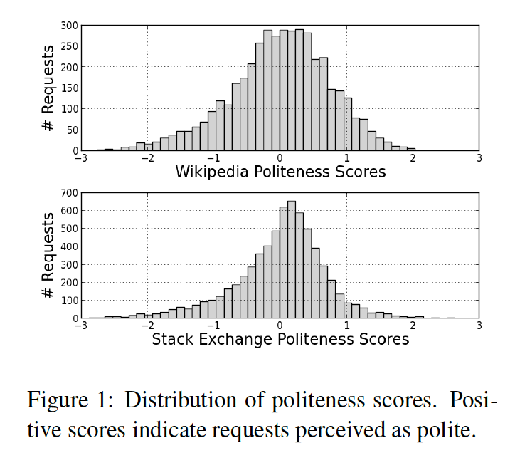
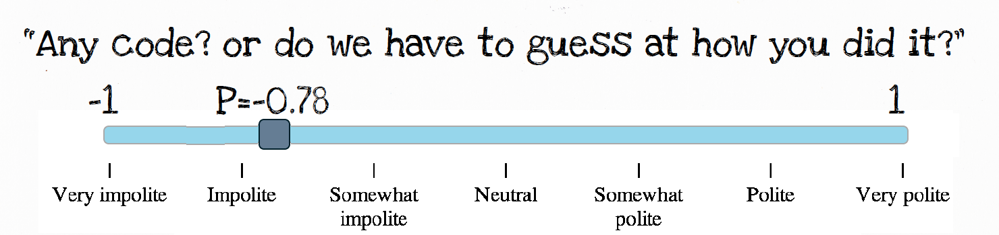
Examples – Binary Sentiment
Data: a new corpus of requests annotated for politeness (From two large online communities in which members frequently make requests of other members: Wikipedia and StackExchange)

Slide 7
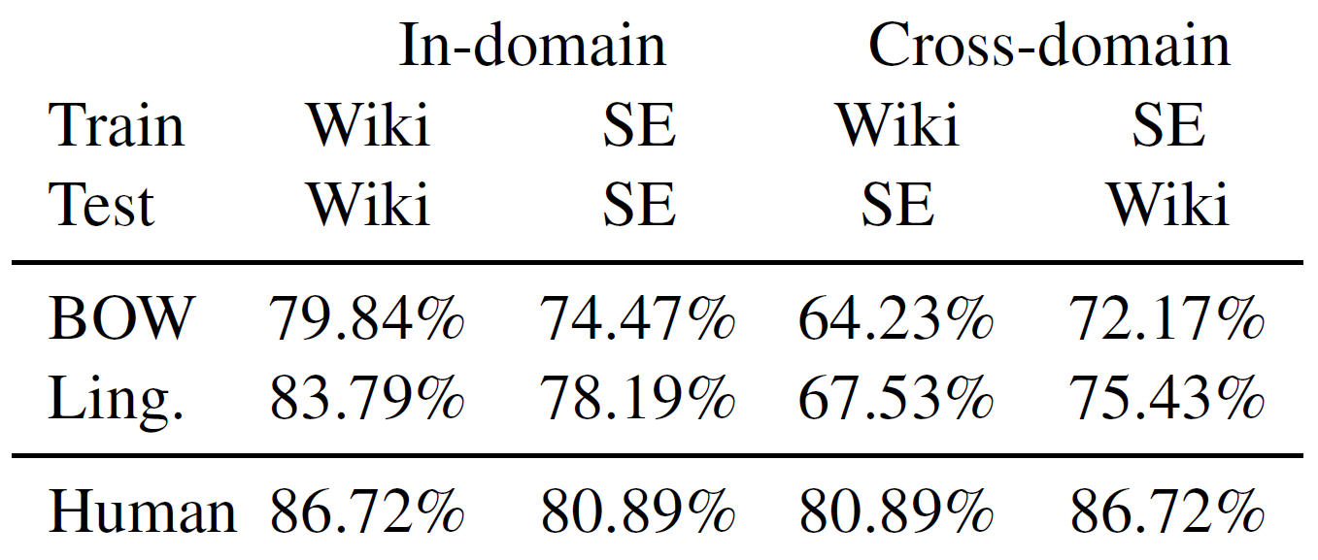
Accuracy

Slide 8
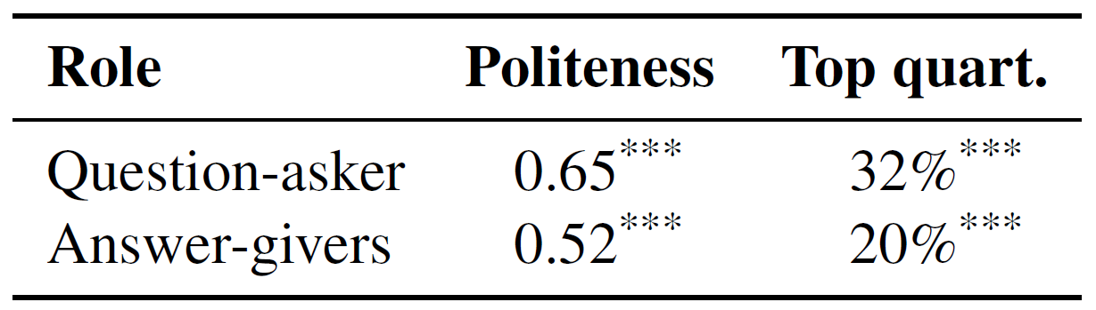
Interesting Results

Slide 9
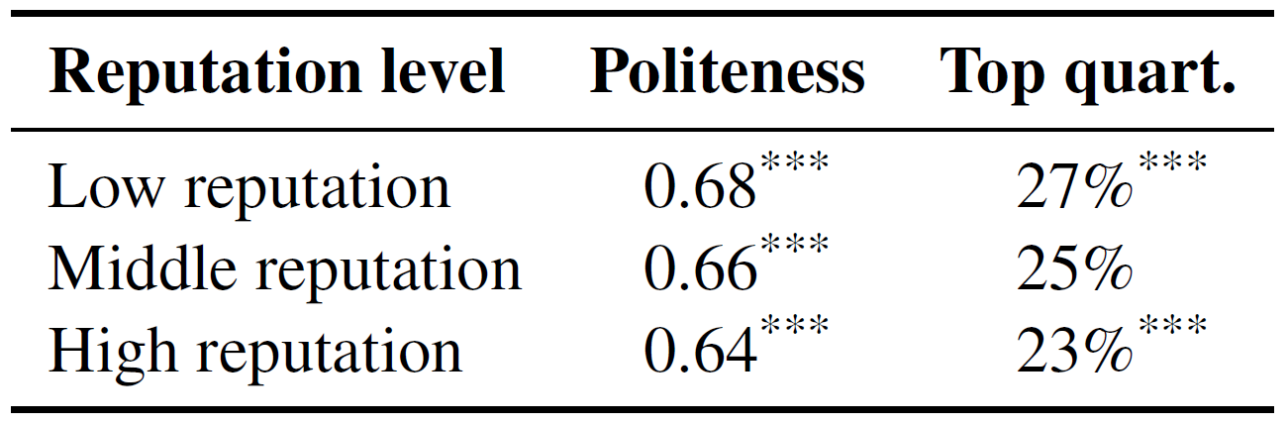
Interesting Results

Slide 10
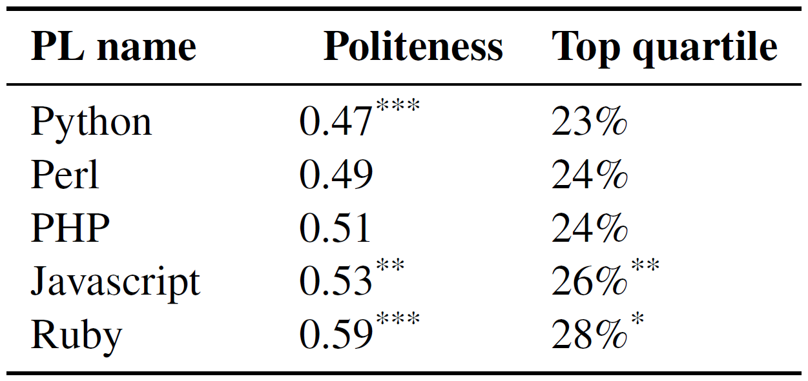
Interesting Results

Slide 11
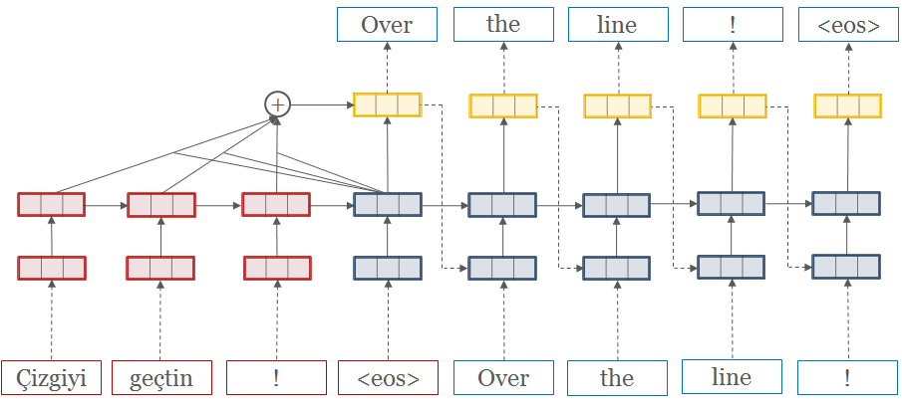
Neural Network and Language
Human
-> Characters
Neural Network
-> Numbers

Slide 12

Converting Characters to Numbers
“… … … … …. The fat cat sat on the mat. … … … … …“
“… … … … …. 32 832 561 634 6132 32 565 … … … … …”

Slide 13
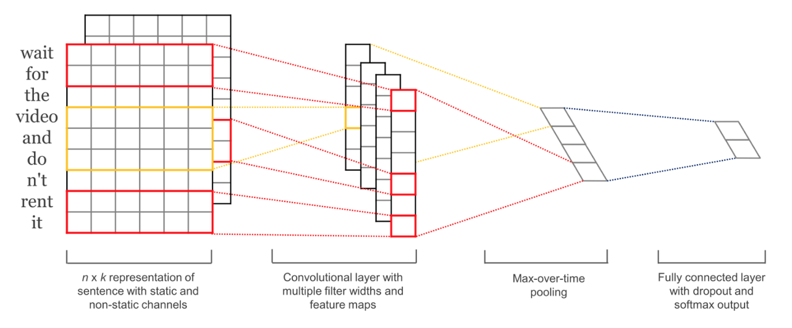
CNN for Sentence Classification
Concatenate the vectors of the words constituting the sentence, and apply CNN
Unlike RNN, only the number of words in the same size as the filter size can be reflected

Slide 14
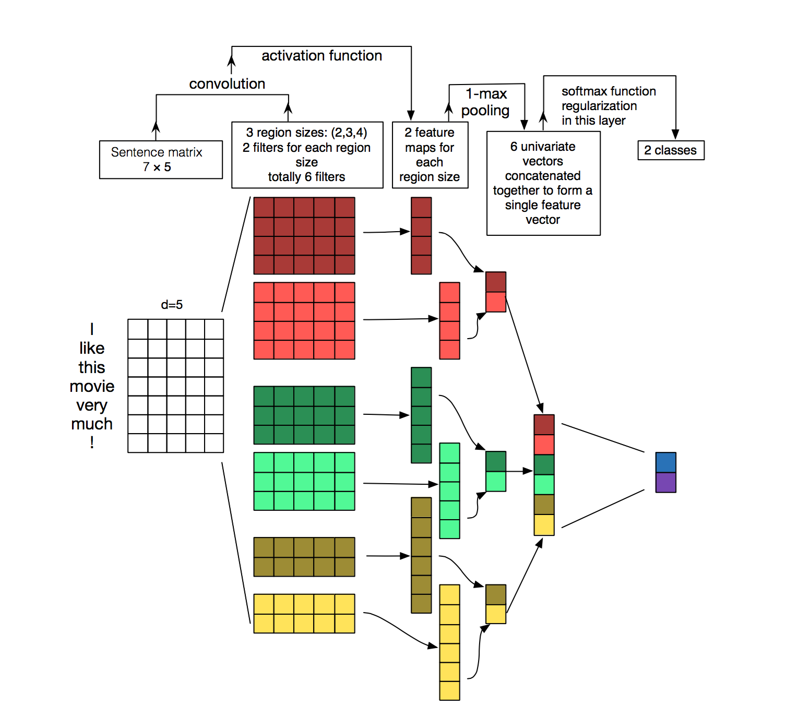
CNN for Sentence Classification

Slide 15
THANKS!
Any questions?

